Slide 1
PL SQL
Dr. Balasundaram A

Slide 2
PL SQL
PL/SQL (Procedural Language/Structured Query Language)

Slide 3
Some differences between SQL and PL/SQL
SQL is executed one statement at a time. PL/SQL is executed as a block of code.
SQL tells the database what to do (declarative), not how to do it. In contrast, PL/SQL tell the database how to do things (procedural).
SQL is used to code queries, DML and DDL statements. PL/SQL is used to code program blocks, triggers, functions, procedures and packages.
You can embed SQL in a PL/SQL program, but you cannot embed PL/SQL within a SQL statement.
3

Slide 4
PL/SQL Block structure
DECLARE (optional)
Variables, cursors, user-defined exceptions
BEGIN (Mandatory)
-SQL statements
-PL/SQL statements
EXCEPTION (optional)
Action to perform when error occur
END;

Slide 5
PL/SQL Block Types
Anonymous
DECLARE
BEGIN
-statements EXCEPTION END;
Procedure
PROCEDURE <name> IS
BEGIN
-statements EXCEPTION END;
Function
FUNCTION <name>
RETURN <datatype> IS
BEGIN
-statements EXCEPTION END;

Slide 6
Steps to create script file
Step1:
SQL> edit z:\oracle\sql\var1.sql
Step2:
Type the program in notepad
Step 3:
Save the program
Step4:
Run the program
SQL> set serveroutput on;
SQL> @z:\oracle\sql\var1.sql

Slide 7
Program 1
/* Remember to SET SERVEROUTPUT ON to see the output */
BEGIN
DBMS_OUTPUT.PUT_LINE('Hello World'); END;
/
7

Slide 8
Program 2
Write a program to print your name and regno.
declare
v_name varchar2(10);
v_regno number;
begin
v_name:='venkat';
v_regno:=39;
dbms_output.put_line( 'the name is' || v_name); dbms_output.put_line('the no is' || v_regno);
end;
/

Slide 9
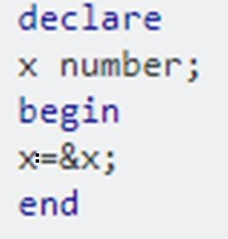
Input

Slide 10
Program 3
Write a program to retrieve ssn number of employee whose name is x.
Assume the following table:
SSN NAME ESSN DEPTNO
SALARY
101 | x | 102 | 1
102 | y | 103 | 2
103 | z | 102 | 3
104 | p | 102 | 4

Slide 11
Program 3a
declare
v_no number; begin
select ssn into v_no from emp where name='x'; dbms_output.put_line(v_no);
end;
/

Slide 12
Program 3b
declare
v_no emp.ssn%type; begin
select ssn into v_no from emp where name='x'; dbms_output.put_line(v_no);
end;
/

Slide 13
Program 3c
declare
v_no emp.ssn%type; begin
select ssn into v_no from emp where name=‘&name'; dbms_output.put_line(v_no);
end;
/

Slide 14
Program 4
SQL>
 |  | declare
 |  | a integer;
 |  | b integer;
 |  | c integer;
 |  | begin
 |  | a:=10;
 |  | b:=12;
 |  | c:=a+b;
 |  | dbms_output.put_line('c is'||c);
end;
/
c is22
PL/SQL procedure successfully completed.

Slide 15
Program 5
SQL> declare
amt integer;
begin
select amount into amt from loan where loan_no='&loan_number';
dbms_output.put_line('amount is'||amt);
end;
/
Enter value for loan_number: 1_11
old 4: select amount into amt from loan where
loan_no='&loan_number';
new 4: select amount into amt from loan where loan_no='1_11';
amount is900
PL/SQL procedure successfully completed.

Slide 16
Statements

Slide 17
PL_SQL Statements
1. IF statements
If –then-end if
If-then-else-end if
If-then-elseif-end if
Case expressions
Loop statements
For loops
While loops

Slide 18
IF Syntax
If condition then
Statements;
Else if condition then
Statements;
Else
Statements;
End if;

Slide 19
If statement
IF total_sales <= 0 THEN no_revenue := TRUE;
ELSE no_revenue := FALSE; END IF;
IF total_sales <= 0 THEN no_revenue := TRUE; ELSIF total_sales > 0 THEN no_revenue := FALSE; END IF;

Slide 20
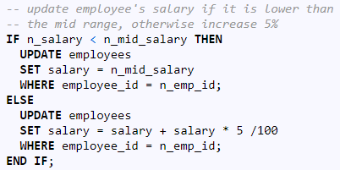
Program – If with SQL

Slide 21
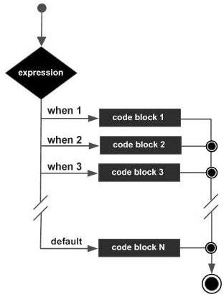
CASE

Slide 22
CASE
CASE selector
WHEN
expression1 THEN result1
WHEN
expression2 THEN result2
---------
WHEN expression N THEN result N
[ELSE resultN+1]
END;

Slide 23
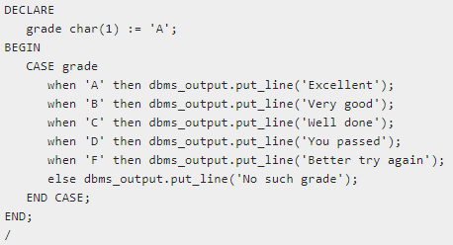
Program - Case

Slide 24
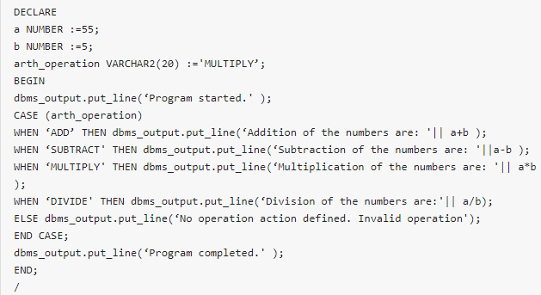
Program2-Case

Slide 25
CASE - Example
declare
va varchar2(10);
v_result varchar2(10);
begin
va:=&va;
v_result:=
CASE va
WHEN 'a' THEN 'excellent' 9 WHEN 'b' THEN 'very good' 10 WHEN 'c' THEN 'good'
ELSE 'poor'
end;
dbms_output.put_line('grade is'||v_result);
end;
/

Slide 26
FOR LOOP
FOR <loop_variable> in <lower_limit> .. <higher_limit> LOOP
sequence_of_statements END LOOP;

Slide 27
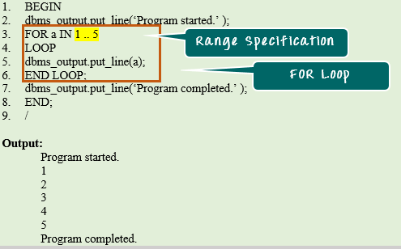
FOR LOOP

Slide 28
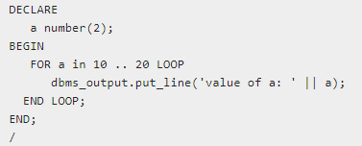
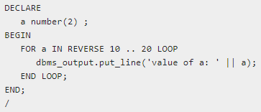

Slide 29
While Loop
WHILE <exit_condition> LOOP sequence_of_statements END LOOP;

Slide 30
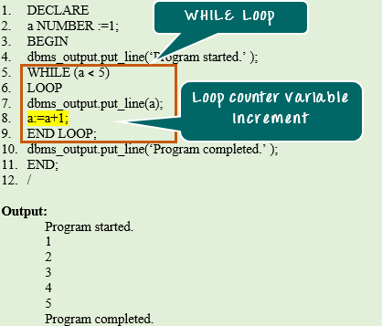

Slide 31
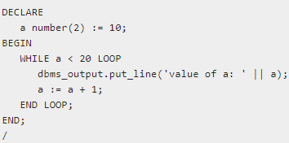
While loop

Slide 32
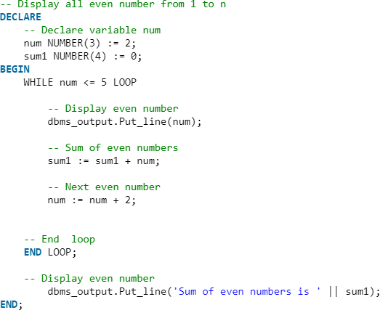
While

